Slide 1
VE281 Data Structures and Algorithms
Shortest Path
Learning Objectives:
Know the shortest path problem
Know Dijkstra’s algorithm and its runtime complexity
Know the similarity between Prim’s algorithm and Dijkastra’s algorithm

Slide 2
Outline
Shortest Path Problem
Unweighted Graph
Dijkstra’s Algorithm

Slide 3
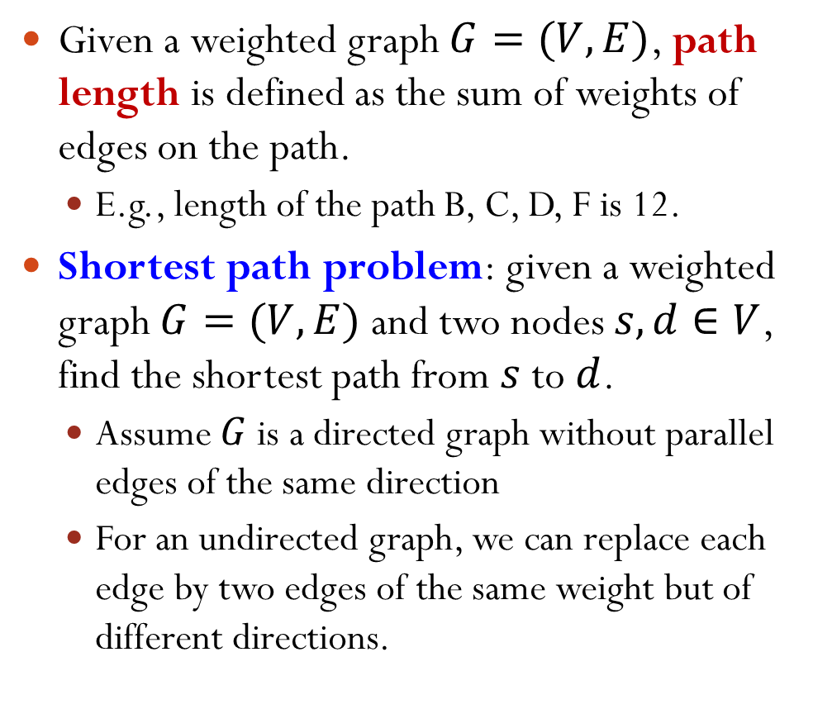
Shortest Path Problem Introduction
Given a weighted graph $G=(V,E)$, path length is defined as the sum of weights of edges on the path.
E.g., length of the path B, C, D, F is 12.
Shortest path problem: given a weighted graph $G=(V,E)$ and two nodes $s,d∈V$, find the shortest path from $s$ to $d$.
Assume $G$ is a directed graph without parallel edges of the same direction
For an undirected graph, we can replace each edge by two edges of the same weight but of different directions.
A
3
1
5
B
5
C
2
D
4
5
4
E
F
What is the shortest path from B to F?
Notes:
If we have parallel edges, then we simply keep the smallest edge.
The shortest path is B->A->C->D->F, with length 11.

Slide 4
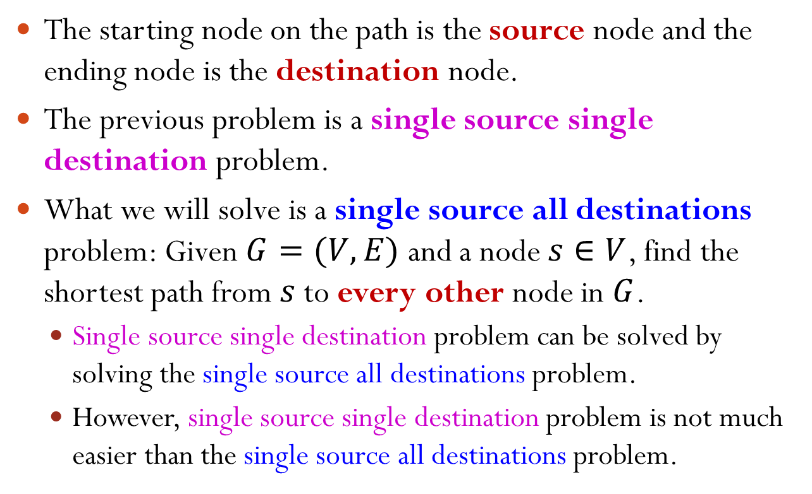
Shortest Path Problem
The starting node on the path is the source node and the ending node is the destination node.
The previous problem is a single source single destination problem.
What we will solve is a single source all destinations problem: Given $G=(V,E)$ and a node $s∈V$, find the shortest path from $s$ to every other node in $G$.
Single source single destination problem can be solved by solving the single source all destinations problem.
However, single source single destination problem is not much easier than the single source all destinations problem.

Slide 5
Shortest Path Problem A Simple Version: Unweighted Graphs
For an unweighted graph, path length is defined as the number of edges on the path.
How do you obtain the shortest path between a pair of nodes?
A
What is the shortest path from B to F?
B
C
D
Using breadth-first search!
E
F

Slide 6
Shortest Path for Unweighted Graphs
Recall breadth-first search (BFS): Given a start node, visit all directly connected neighbors first, then nodes 2 hops away, 3 hops away, and so on.
This is exactly what we want!
When the node visited is the destination node, we stop.
When the queue becomes empty, there is no path between the two nodes.
A
start node
A
direct neighbor
B
C
D
B
C
D
nodes 2 hops away
F
E
F
E
nodes 3 hops away

Slide 7
Shortest Path for Unweighted Graphs
Additional bookkeeping
Store the distance.
Store the predecessor on the shortest path, i.e., the previous node on the path.
start node
nodes 2 hops away
A
A
direct neighbor
nodes 3 hops away
B
C
D
B
C
D
 | A | B | C | D | E | F
dist | 1 | 0 | 1 | 2 | 2 | 3
pred | B | - | B | A | C | D
F
E
F
E

Slide 8
Shortest Path for Unweighted Graphs
We can obtain the shortest path by backtracking.
E.g., shortest path from B to F
B→A→D→F
start node
nodes 2 hops away
A
A
direct neighbor
nodes 3 hops away
B
C
D
B
C
D
 | A | B | C | D | E | F
dist | 1 | 0 | 1 | 2 | 2 | 3
prev | B | - | B | A | C | D
F
E
F
E

Slide 9


Outline
Shortest Path Problem
Unweighted Graph
Dijkstra’s Algorithm
Course Eval
Question 17
Question 18
Thumbs up and subscribe
点赞关注收藏
一件三连

Slide 10
Shortest Path for Weighted Graphs
The problem becomes more difficult when edges have different weights.
Breadth-first search won’t work!
What is the shortest path from B to F?
If the weights are non-negative, then we can apply Dijkstra’s Algorithm (more details & examples from Ve203)
Works only when all weights are non-negative
A greedy algorithm for solving single source all destinations shortest path problem
A
3
1
5
B
5
C
2
D
4
5
4
E
F
Notes:
Breadth-first search does not work. What we get from BFS is B->A->D->F, with length 13.
However, the shortest path is B->A->C->D->F, with length 11.

Slide 11
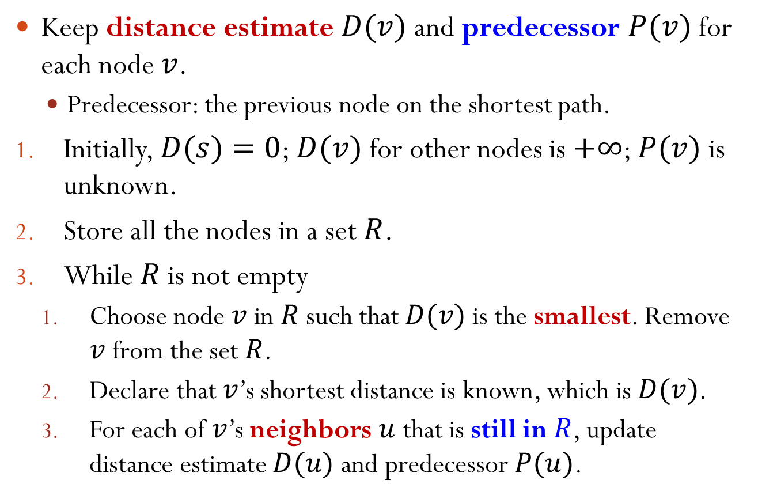
Dijkstra’s Algorithm
Keep distance estimate $D(v)$ and predecessor $P(v)$ for each node $v$.
Predecessor: the previous node on the shortest path.
Initially, $D(s)=0$; $D(v)$ for other nodes is $+∞$; $P(v)$ is unknown.
Store all the nodes in a set $R$.
While $R$ is not empty
Choose node $v$ in $R$ such that $D(v)$ is the smallest. Remove $v$ from the set $R$.
Declare that $v$’s shortest distance is known, which is $D(v)$.
For each of $v$’s neighbors $u$ that is still in $R$, update distance estimate $D(u)$ and predecessor $P(u)$.

Slide 12

Updating
For each of $v$’s neighbors $u$ that is still in $R$, if $D(v)+w(v,u)<D(u)$, then update $D(u)=D(v)+w(v,u)$ and the predecessor $P(u)=v$.
I.e., update $D(u)$ if the path going through $v$ is shorter than the best path so far to $u$.

Slide 13
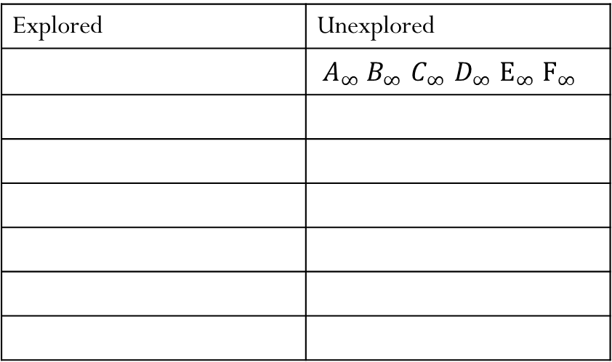
Example A->E
Explored | Unexplored
 | $A_{∞}^{}$ $B_{∞}^{}$ $C_{∞}^{}$ $D_{∞}^{}$ $E_{∞}^{}$ $F_{∞}^{}$
A
3
1
5
B
5
C
2
D
4
5
4
E
F
Notes:
Breadth-first search does not work. What we get from BFS is B->A->D->F, with length 13.
However, the shortest path is B->A->C->D->F, with length 11.

Slide 14
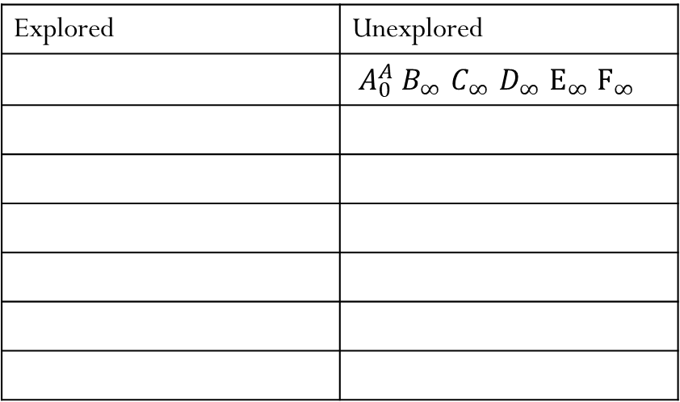
Example
Explored | Unexplored
 | $A_{0}^{A}$ $B_{∞}^{}$ $C_{∞}^{}$ $D_{∞}^{}$ $E_{∞}^{}$ $F_{∞}^{}$
A
3
1
5
B
5
C
2
D
4
5
4
E
F
Notes:
Breadth-first search does not work. What we get from BFS is B->A->D->F, with length 13.
However, the shortest path is B->A->C->D->F, with length 11.

Slide 15
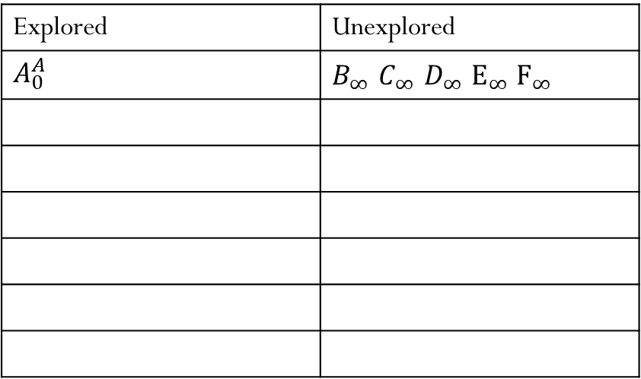
Example
Explored | Unexplored
$A_{0}^{A}$ | $B_{∞}^{}$ $C_{∞}^{}$ $D_{∞}^{}$ $E_{∞}^{}$ $F_{∞}^{}$
A
3
1
5
B
5
C
2
D
4
5
4
E
F
Notes:
Breadth-first search does not work. What we get from BFS is B->A->D->F, with length 13.
However, the shortest path is B->A->C->D->F, with length 11.

Slide 16
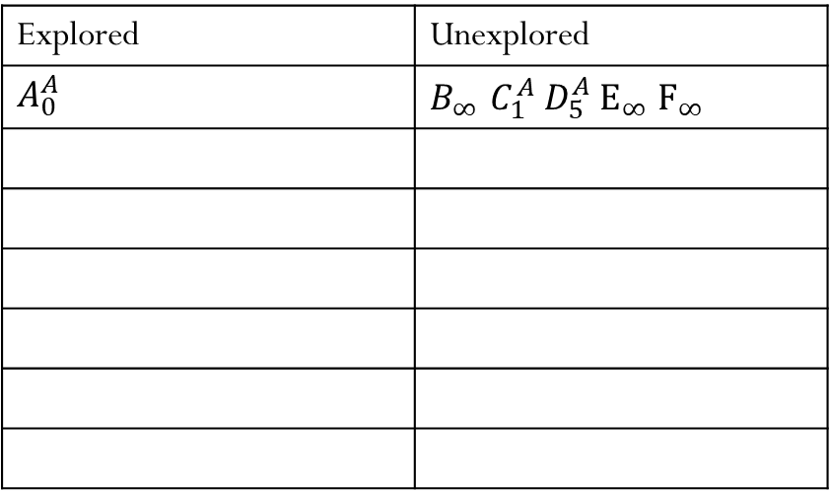
Example
Explored | Unexplored
$A_{0}^{A}$ | $B_{∞}^{}$ $C_{1}^{A}$ $D_{5}^{A}$ $E_{∞}^{}$ $F_{∞}^{}$
A
3
1
5
B
5
C
2
D
4
5
4
E
F
Notes:
Breadth-first search does not work. What we get from BFS is B->A->D->F, with length 13.
However, the shortest path is B->A->C->D->F, with length 11.

Slide 17
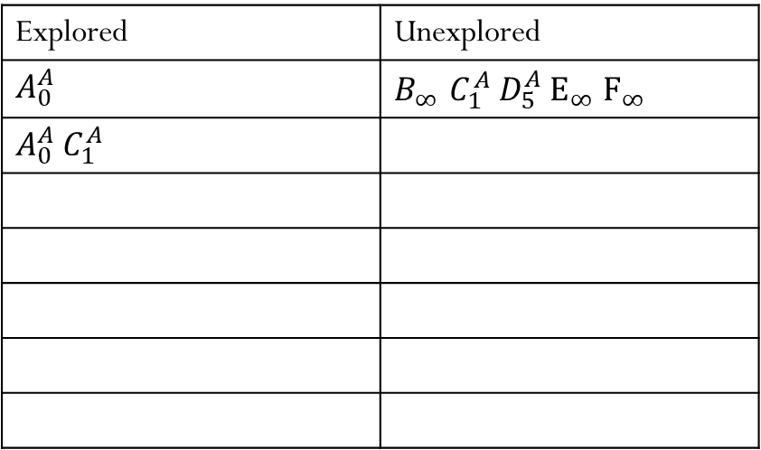
Example
Explored | Unexplored
$A_{0}^{A}$ | $B_{∞}^{}$ $C_{1}^{A}$ $D_{5}^{A}$ $E_{∞}^{}$ $F_{∞}^{}$
$A_{0}^{A}$ $C_{1}^{A}$
A
3
1
5
B
5
C
2
D
4
5
4
E
F
Notes:
Breadth-first search does not work. What we get from BFS is B->A->D->F, with length 13.
However, the shortest path is B->A->C->D->F, with length 11.

Slide 18
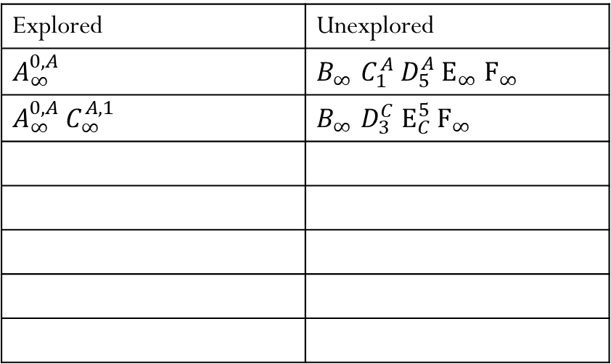
Example
Explored | Unexplored
$A_{∞}^{0,A}$ | $B_{∞}^{}$ $C_{1}^{A}$ $D_{5}^{A}$ $E_{∞}^{}$ $F_{∞}^{}$
$A_{∞}^{0,A}$ $C_{∞}^{A,1}$ | $B_{∞}^{}$ $D_{3}^{C}$ $E_{C}^{5}$ $F_{∞}^{}$
A
3
1
5
B
5
C
2
D
4
5
4
E
F
Notes:
Breadth-first search does not work. What we get from BFS is B->A->D->F, with length 13.
However, the shortest path is B->A->C->D->F, with length 11.

Slide 19
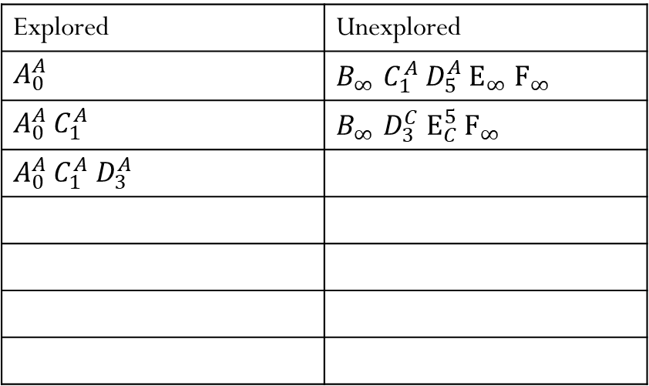
Example
Explored | Unexplored
$A_{0}^{A}$ | $B_{∞}^{}$ $C_{1}^{A}$ $D_{5}^{A}$ $E_{∞}^{}$ $F_{∞}^{}$
$A_{0}^{A}$ $C_{1}^{A}$ | $B_{∞}^{}$ $D_{3}^{C}$ $E_{C}^{5}$ $F_{∞}^{}$
$A_{0}^{A}$ $C_{1}^{A}$ $D_{3}^{A}$
A
3
1
5
B
5
C
2
D
4
5
4
E
F
Notes:
Breadth-first search does not work. What we get from BFS is B->A->D->F, with length 13.
However, the shortest path is B->A->C->D->F, with length 11.

Slide 20
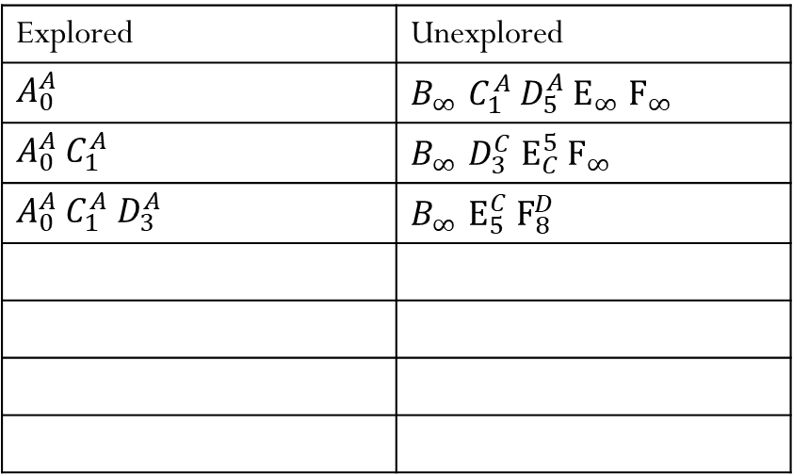
Example
Explored | Unexplored
$A_{0}^{A}$ | $B_{∞}^{}$ $C_{1}^{A}$ $D_{5}^{A}$ $E_{∞}^{}$ $F_{∞}^{}$
$A_{0}^{A}$ $C_{1}^{A}$ | $B_{∞}^{}$ $D_{3}^{C}$ $E_{C}^{5}$ $F_{∞}^{}$
$A_{0}^{A}$ $C_{1}^{A}$ $D_{3}^{A}$ | $B_{∞}^{}$ $E_{5}^{C}$ $F_{8}^{D}$
A
3
1
5
B
5
C
2
D
4
5
4
E
F
Notes:
Breadth-first search does not work. What we get from BFS is B->A->D->F, with length 13.
However, the shortest path is B->A->C->D->F, with length 11.

Slide 21
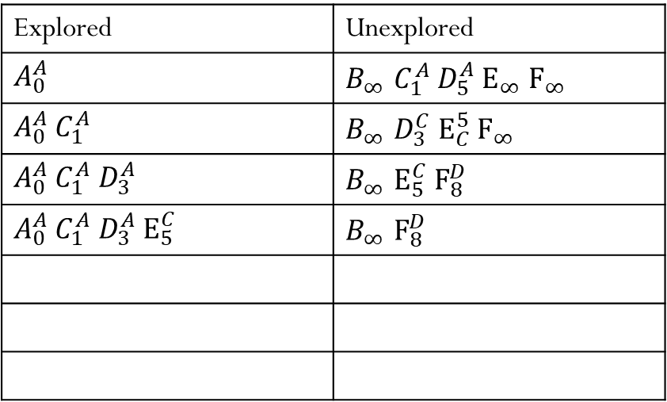
Example
Explored | Unexplored
$A_{0}^{A}$ | $B_{∞}^{}$ $C_{1}^{A}$ $D_{5}^{A}$ $E_{∞}^{}$ $F_{∞}^{}$
$A_{0}^{A}$ $C_{1}^{A}$ | $B_{∞}^{}$ $D_{3}^{C}$ $E_{C}^{5}$ $F_{∞}^{}$
$A_{0}^{A}$ $C_{1}^{A}$ $D_{3}^{A}$ | $B_{∞}^{}$ $E_{5}^{C}$ $F_{8}^{D}$
$A_{0}^{A}$ $C_{1}^{A}$ $D_{3}^{A}$ $E_{5}^{C}$ | $B_{∞}^{}$ $F_{8}^{D}$
A
3
1
5
B
5
C
2
D
4
5
4
E
F
Notes:
Breadth-first search does not work. What we get from BFS is B->A->D->F, with length 13.
However, the shortest path is B->A->C->D->F, with length 11.

Slide 22
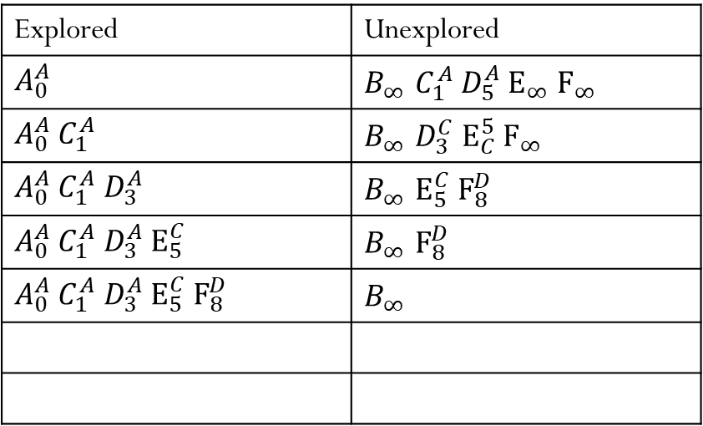
Example
Explored | Unexplored
$A_{0}^{A}$ | $B_{∞}^{}$ $C_{1}^{A}$ $D_{5}^{A}$ $E_{∞}^{}$ $F_{∞}^{}$
$A_{0}^{A}$ $C_{1}^{A}$ | $B_{∞}^{}$ $D_{3}^{C}$ $E_{C}^{5}$ $F_{∞}^{}$
$A_{0}^{A}$ $C_{1}^{A}$ $D_{3}^{A}$ | $B_{∞}^{}$ $E_{5}^{C}$ $F_{8}^{D}$
$A_{0}^{A}$ $C_{1}^{A}$ $D_{3}^{A}$ $E_{5}^{C}$ | $B_{∞}^{}$ $F_{8}^{D}$
$A_{0}^{A}$ $C_{1}^{A}$ $D_{3}^{A}$ $E_{5}^{C}$ $F_{8}^{D}$ | $$B_{∞}^{}$$
A
3
1
5
B
5
C
2
D
4
5
4
E
F
Notes:
Breadth-first search does not work. What we get from BFS is B->A->D->F, with length 13.
However, the shortest path is B->A->C->D->F, with length 11.

Slide 23
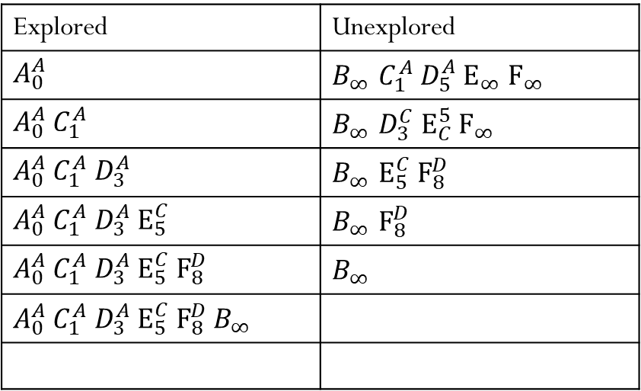
Example
Explored | Unexplored
$A_{0}^{A}$ | $B_{∞}^{}$ $C_{1}^{A}$ $D_{5}^{A}$ $E_{∞}^{}$ $F_{∞}^{}$
$A_{0}^{A}$ $C_{1}^{A}$ | $B_{∞}^{}$ $D_{3}^{C}$ $E_{C}^{5}$ $F_{∞}^{}$
$A_{0}^{A}$ $C_{1}^{A}$ $D_{3}^{A}$ | $B_{∞}^{}$ $E_{5}^{C}$ $F_{8}^{D}$
$A_{0}^{A}$ $C_{1}^{A}$ $D_{3}^{A}$ $E_{5}^{C}$ | $B_{∞}^{}$ $F_{8}^{D}$
$A_{0}^{A}$ $C_{1}^{A}$ $D_{3}^{A}$ $E_{5}^{C}$ $F_{8}^{D}$ | $$B_{∞}^{}$$
$A_{0}^{A}$ $C_{1}^{A}$ $D_{3}^{A}$ $E_{5}^{C}$ $F_{8}^{D}$ $B_{∞}^{}$
A
3
1
5
B
5
C
2
D
4
5
4
E
F
Notes:
Breadth-first search does not work. What we get from BFS is B->A->D->F, with length 13.
However, the shortest path is B->A->C->D->F, with length 11.

Slide 24
Why Does it Work?
Proof by induction
All nodes in set Explored already have shortest paths
Node in set Unexplored with the smallest distance has the shortest path
b is already the shortest distance to C
Set Explored
Set Unexplored
A
b+a is already the smallest distance to G through C
a
G
b
C
f
b+a ≤ c+d
d
J
c
M
b+a ≤ c+d+f

Slide 25
Dijkstra’s Algorithm v.s. Prim’s Algorithm
Dijkstra’s algorithm is similar to Prim’s algorithm
Prim’s algorithm: grow the set of nodes we add to the MST.
Dijkstra’s algorithm: grow the set of nodes to which we know the shortest path.

Slide 26
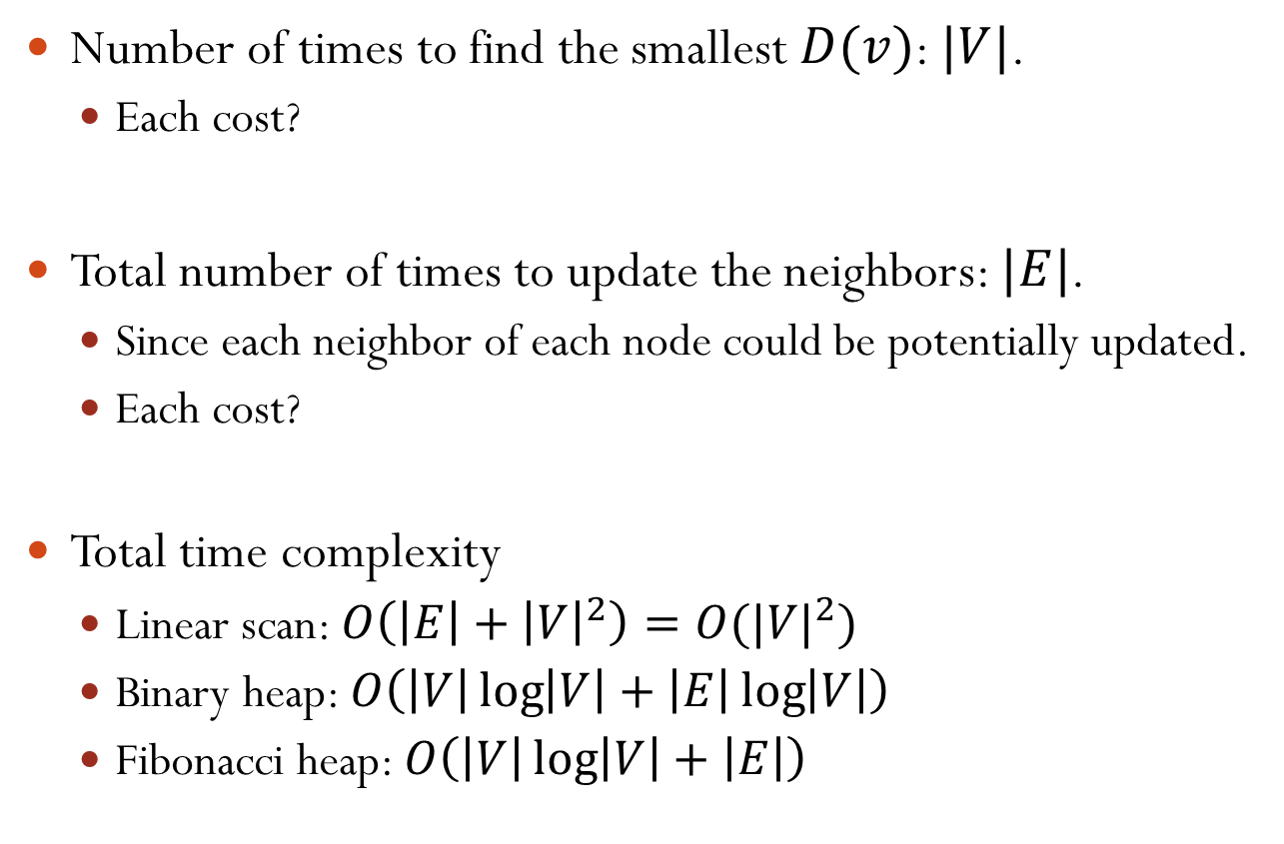
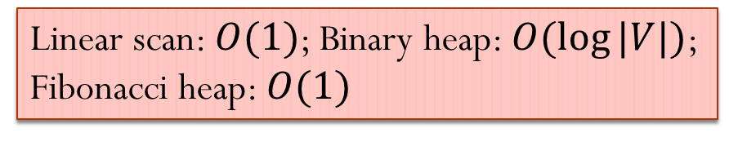
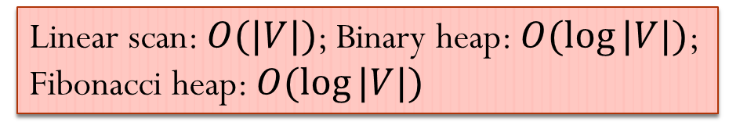
Dijkstra’s Algorithm Time Complexity
Number of times to find the smallest $D(v)$: $|V|$.
Each cost?
Total number of times to update the neighbors: $|E|$.
Since each neighbor of each node could be potentially updated.
Each cost?
Total time complexity
Linear scan: $O\left(\left|E\right|+{\left|V\right|}^{2}\right)=O({|V|}^{2})$
Binary heap: $O\left(\left|V\right|\log\left|V\right|+\left|E\right|\log\left|V\right|\right)$
Fibonacci heap: $O\left(\left|V\right|\log\left|V\right|+\left|E\right|\right)$
Linear scan: $O(|V|)$; Binary heap: $O(log⁡|V|)$;
Fibonacci heap: $O(log⁡|V|)$
Linear scan: $O(1)$; Binary heap: $O(log⁡|V|)$;
Fibonacci heap: $O(1)$
Notes:
Which one is better?

